Slide 1


Change Request Analysis
CR1: User percentge time of advertising seen

Slide 2
Statement
“By measuring the time the user expends watching advertising, we should be able to develop a more efficient and profitable marketing campaign.”
Considering:
Length of video (minutes).
The type of product or service offering.
Previous purchases the user have made.
Demography of the user.

Slide 3
Implications
This regards on the importance of advertising for this platform. We’re selling a platform that will get people to purchase the products they want and need, therefore, the publicity there shown must match their likes and interests.

Slide 4
Implications
Thus, the fact of knowing how much time the user expends on advertising will help us know in what they like the most and, more importantly, learn what type of adds they are more likely to watch and, eventually, purchase a product or a service.
Since our mayor income comes from advertising, the success of the investors is ours as well.

Slide 5
Analysis criteria
Functionality: To evaluate if implementing CR would require adding, remove or modify the existing functionality of a module.
Data: To assess if the type of data that the module receives, outputs or processes is compatible with the needs of the CR.
Performance: To estimate if the predefined computational resources of the system will suffice the CR’s computational intensity.
Dependencies: To check if the module depend on other modules or components that may be affected by the CR.
Documentation: To verify if the request needs modifications to the existing documentation or the addition of new documentation to reflect the changes made to the module.
Costs: To consider the importance of this change regarding the extra cost to invest in the proyect

Slide 6
Modules affected
To begin with, all of the changes will only affect the server side of the system. By the nature of the CR1, the modules affected require changes on its functionalities.
Data collection and data analysis, data encryption.
New terms and conditions for the users.
Advertising features. New module
Support for 3rd parties’ plugins.

Slide 7
Costs analysis
Database for storage all the information, in the essence of the DB Management software as well as the design.
Encryption of the user’s information
Data analysis of user’s behavior.
3rd party integration for e-shops, healthcare, and services.

Slide 8
Technical implications

Slide 9
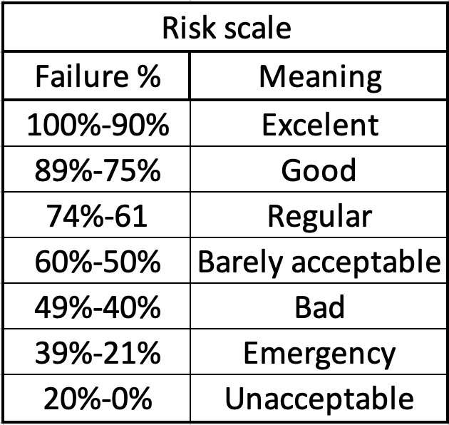
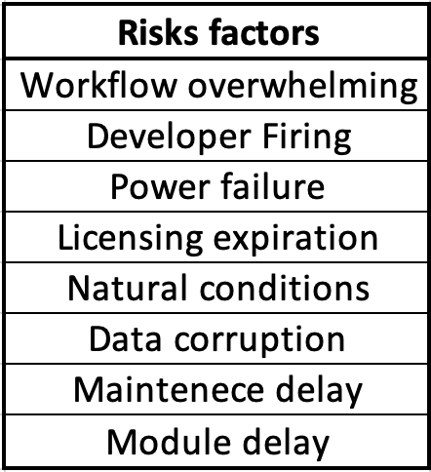
Risks analysis

Slide 10
Effort analysis

Slide 11
Priority scale and analysis

